Slide 1


Hasan Beker
08.01.2024

Slide 2

Outline
Executive Summary
Introduction
Methodology
Results
Conclusion
Appendix

Slide 3
Executive Summary
Summary of methodologies
Data Collection through API
Data Collection with Web Scraping
Data Wrangling
Exploratory Data Analysis with SQL
Exploratory Data Analysis with Data Visualization
Interactive Visual Analytics with Folium
Machine Learning Prediction
Summary of all results
Exploratory Data Analysis result
Interactive analytics in screenshots
Predictive Analytics result

Slide 4
Introduction
Project background and context
Space X advertises Falcon 9 rocket launches on its website with a cost of 62 million dollars; other providers cost upward of 165 million dollars each, much of the savings is because Space X can reuse the first stage. Therefore, if we can determine if the first stage will land, we can determine the cost of a launch. This information can be used if an alternate company wants to bid against space X for a rocket launch. This goal of the project is to create a machine learning pipeline to predict if the first stage will land successfully.
Problems you want to find answers
What factors determine if the rocket will land successfully?
The interaction amongst various features that determine the success rate of a successful landing.
What operating conditions needs to be in place to ensure a successful landing program.

Slide 5

Section 1

Slide 6
Methodology
Executive Summary
Data collection methodology:
Describe how data was collected
Perform data wrangling
Describe how data was processed
Perform exploratory data analysis (EDA) using visualization and SQL
Perform interactive visual analytics using Folium and Plotly Dash
Perform predictive analysis using classification models
How to build, tune, evaluate classification models

Slide 7
Data Collection
The data was collected using various methods
Data collection was done using get request to the SpaceX API.
Next, we decoded the response content as a Json using .json() function call and turn it into a pandas dataframe using .json_normalize().
We then cleaned the data, checked for missing values and fill in missing values where necessary.
In addition, we performed web scraping from Wikipedia for Falcon 9 launch records with BeautifulSoup.
The objective was to extract the launch records as HTML table, parse the table and convert it to a pandas dataframe for future analysis.

Slide 8
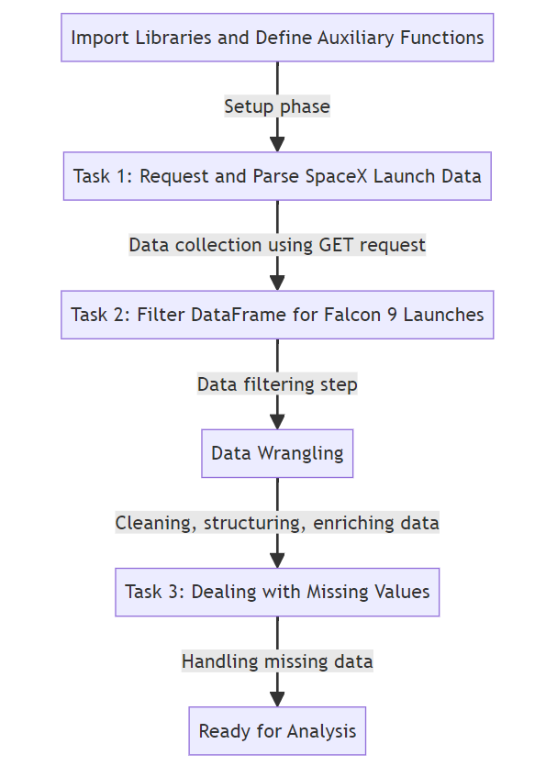
Data Collection – SpaceX API
We used the get request to the SpaceX API to collect data, clean the requested data and did some basic data wrangling and formatting.
The link to the notebook is https://github.com/HasanBeker2/Week_1_Introduction_and_Understand_the_Data_Sets/blob/master/jupyter-labs-spacex-data-collection-api.ipynb

Slide 9
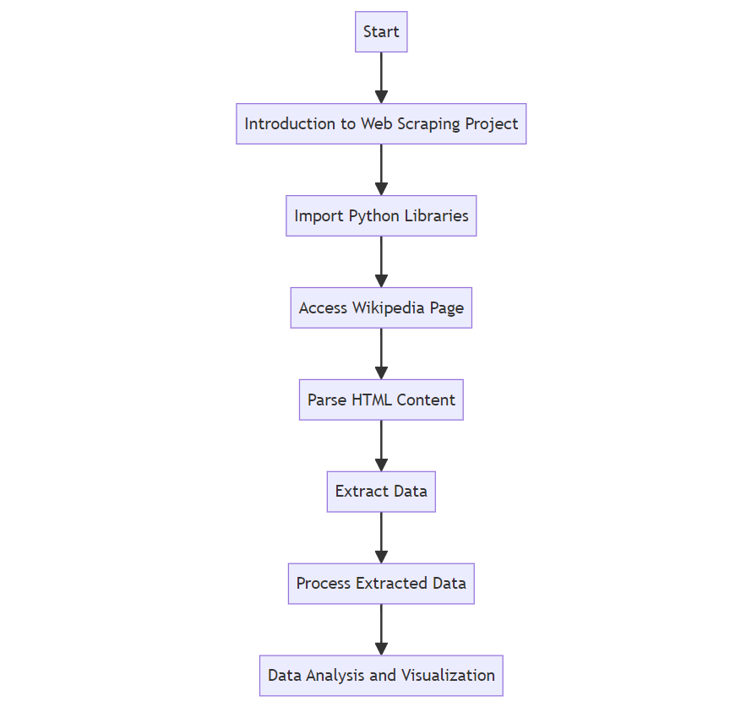
Data Collection - Scraping
We applied web scrapping to webscrape Falcon 9 launch records with BeautifulSoup
We parsed the table and converted it into a pandas dataframe.
The link to the notebook is https://github.com/HasanBeker2/Week_1_Introduction_and_Understand_the_Data_Sets/blob/master/jupyter-labs-webscraping.ipynb

Slide 10

Data Wrangling
We performed exploratory data analysis and determined the training labels.
We calculated the number of launches at each site, and the number and occurrence of each orbits
We created landing outcome label from outcome column and exported the results to csv.
The link to the notebook is https://github.com/HasanBeker2/Week_1_Introduction_and_Understand_the_Data_Sets/blob/master/labs-jupyter-spacex-Data%20wrangling.ipynb

Slide 11
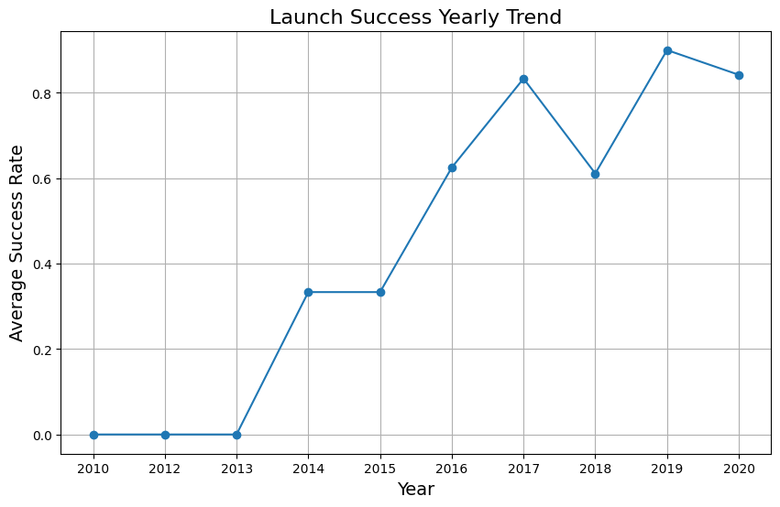
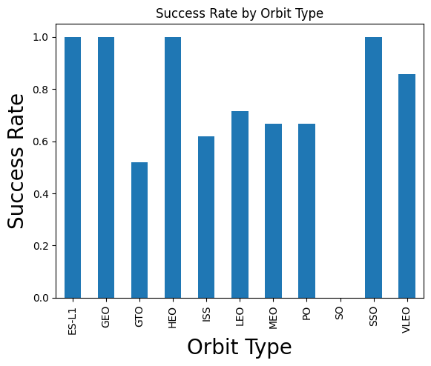
EDA with Data Visualization
We explored the data by visualizing the relationship between flight number and launch Site, payload and launch site, success rate of each orbit type, flight number and orbit type, the launch success yearly trend.
The link to the notebook is https://github.com/HasanBeker2/Week_2_Complete-the-EDA-with-SQL/blob/master/jupyter-labs-eda-dataviz.ipynb

Slide 12
EDA with SQL
We loaded the SpaceX dataset into a PostgreSQL database without leaving the jupyter notebook.
We applied EDA with SQL to get insight from the data. We wrote queries to find out for instance:
The names of unique launch sites in the space mission.
The total payload mass carried by boosters launched by NASA (CRS)
The average payload mass carried by booster version F9 v1.1
The total number of successful and failure mission outcomes
The failed landing outcomes in drone ship, their booster version and launch site names.
The link to the notebook is https://github.com/HasanBeker2/Week_2_Complete-the-EDA-with-SQL/blob/master/jupyter-labs-eda-sql-coursera_sqllite.ipynb

Slide 13
Build an Interactive Map with Folium
We marked all launch sites, and added map objects such as markers, circles, lines to mark the success or failure of launches for each site on the folium map.
We assigned the feature launch outcomes (failure or success) to class 0 and 1.i.e., 0 for failure, and 1 for success.
Using the color-labeled marker clusters, we identified which launch sites have relatively high success rate.
We calculated the distances between a launch site to its proximities. We answered some question for instance:
Are launch sites near railways, highways and coastlines.
Do launch sites keep certain distance away from cities.
Github link is https://github.com/HasanBeker2/Week_3_Interactive_Visual_Analytics_And_Dashboards/blob/master/dash_interactivity.ipynb

Slide 14
Build a Dashboard with Plotly Dash
We built an interactive dashboard with Plotly dash
We plotted pie charts showing the total launches by a certain sites
We plotted scatter graph showing the relationship with Outcome and Payload Mass (Kg) for the different booster version.
The link to the notebook is https://github.com/HasanBeker2/Week_3_Interactive_Visual_Analytics_And_Dashboards/blob/master/dash_interactivity.ipynb

Slide 15
Predictive Analysis (Classification)
We loaded the data using numpy and pandas, transformed the data, split our data into training and testing.
We built different machine learning models and tune different hyperparameters using GridSearchCV.
We used accuracy as the metric for our model, improved the model using feature engineering and algorithm tuning.
We found the best performing classification model.
The link to the notebook is https://github.com/HasanBeker2/Week_4_Predictive_Analysis/blob/master/SpaceX_Machine_Learning_Prediction_Part_5.jupyterlite.ipynb

Slide 16
Results
Exploratory data analysis results
Interactive analytics demo in screenshots
Predictive analysis results

Slide 17

Section 2

Slide 18

Flight Number vs. Launch Site
From the plot, we found that the larger the flight amount at a launch site, the greater the success rate at a launch site.

Slide 19
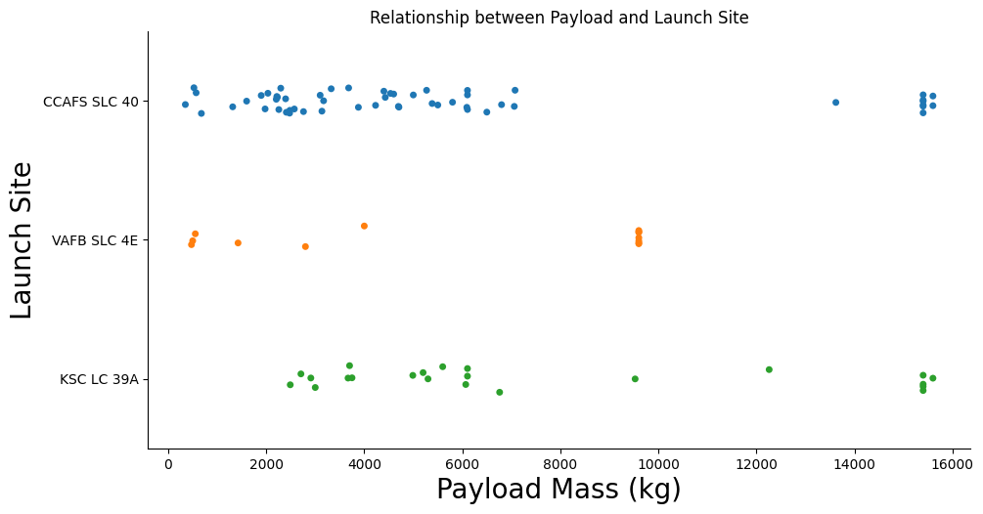
Payload vs. Launch Site
CCAFS SLC 40 is used for a wide range of payload masses, from small to large.
VAFB SLC 4E has fewer launches, with the payload masses generally on the lower end compared to the other sites.
KSC LC 39A is used for launches with a variety of payload masses, though there seems to be a cluster of launches with lower payload masses and a few with very high payload masses.

Slide 20

Success Rate vs. Orbit Type
ES-L1, GEO, and VLEO show the highest success rates, close to 1, suggesting a very high rate of successful missions to these orbits.
GTO and MEO have success rates of around 0.6 to 0.7, which is lower but still suggests a majority of missions are successful.
HEO, ISS, LEO, PO, and SSO have success rates between approximately 0.8 and 0.9, indicating a relatively high level of success.
The success rate for SO is the lowest on the chart, significantly below the others, at about 0.2, indicating that only 20% of missions to this orbit type are successful.

Slide 21
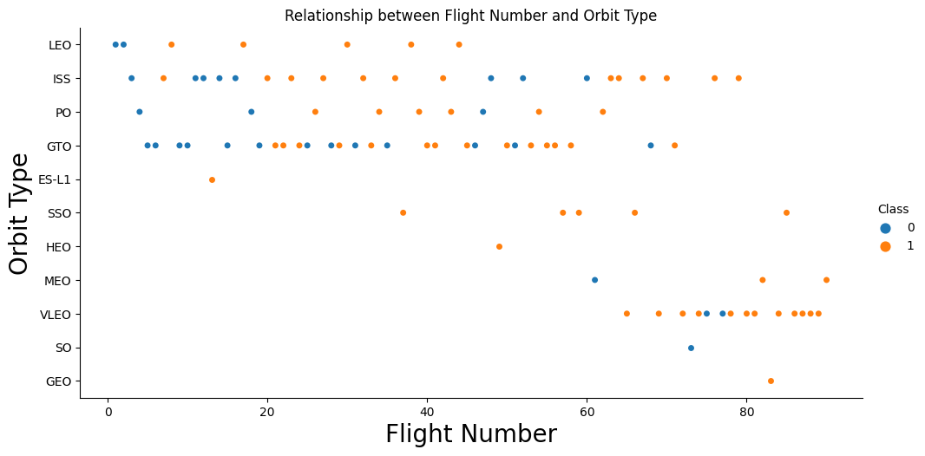
Flight Number vs. Orbit Type
LEO (Low Earth Orbit) has the highest number of flights spread across the flight numbers, indicating frequent missions to this orbit.
GEO (Geostationary Orbit) and SO (Suborbital) have the fewest data points, suggesting fewer flights to these orbits.
Orbits such as ISS (International Space Station), PO (Polar Orbit), and GTO (Geostationary Transfer Orbit) show a moderate number of flights.

Slide 22
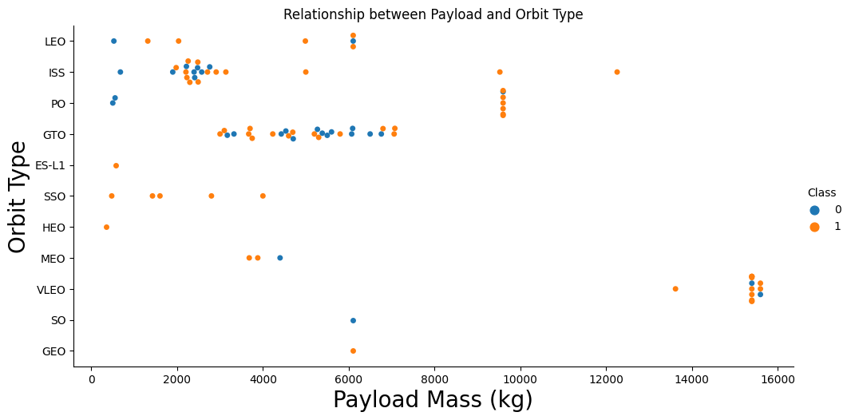
Payload vs. Orbit Type
Show a scatter point of payloLEO and GTO are the most frequently used orbits for a wide range of payload masses.
The GEO orbit shows only two instances with heavy payloads, which may indicate its specialized use for larger satellites.ad vs. orbit type
There are a few instances of very heavy payloads exceeding 10,000 kg, specifically in orbits like GTO and LEO.

Slide 23
Launch Success Yearly Trend
Overall Trend: The graph shows a strong improvement in launch success from nearly 0 in 2010 to over 80% by 2020.
Yearly Variability: Success rates fluctuate notably, especially with a dip after 2016, indicating variable performance across years.
Recent Stability: Success rates level out above 80% from 2018 onwards, suggesting a period of consistent launch reliability.

Slide 24
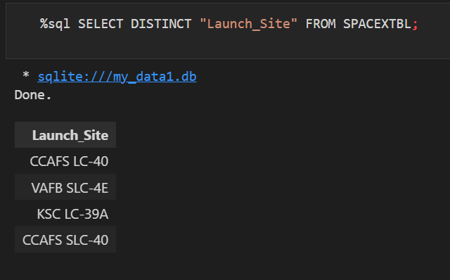
All Launch Site Names
We used the key word DISTINCT to show only unique launch sites from the SpaceX data.

Slide 25
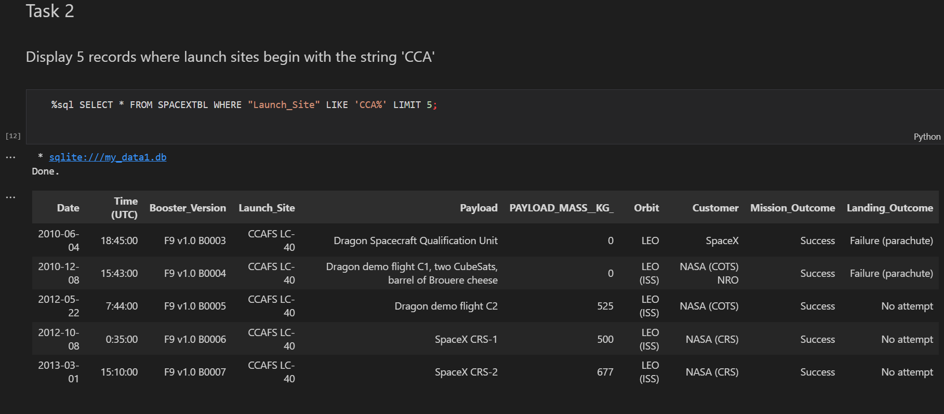
Launch Site Names Begin with 'CCA'
The query was designed to fetch 5 records from a database table named SPACEXTBL where the "Launch_Site" begins with the string 'CCA'.

Slide 26
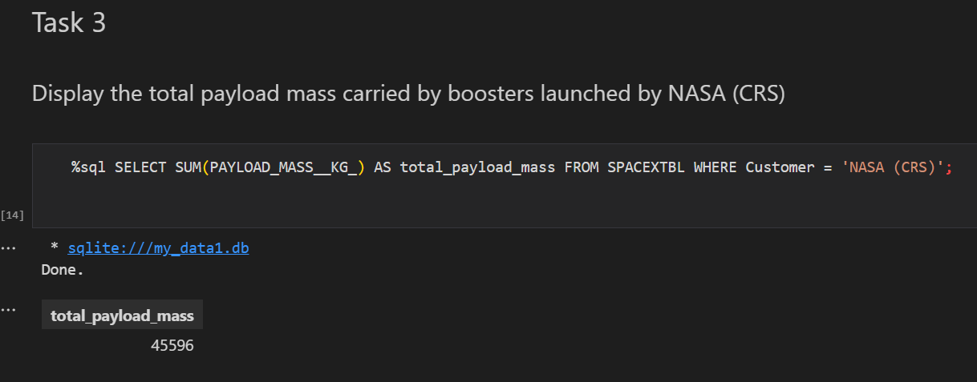
Total Payload Mass
This query sums up the payload mass for all entries in the SPACEXTBL table where the customer is listed as 'NASA (CRS)'. The result of the query is a single value: 45596 kg, which represents the total payload mass carried by all NASA (CRS) missions in the dataset.

Slide 27
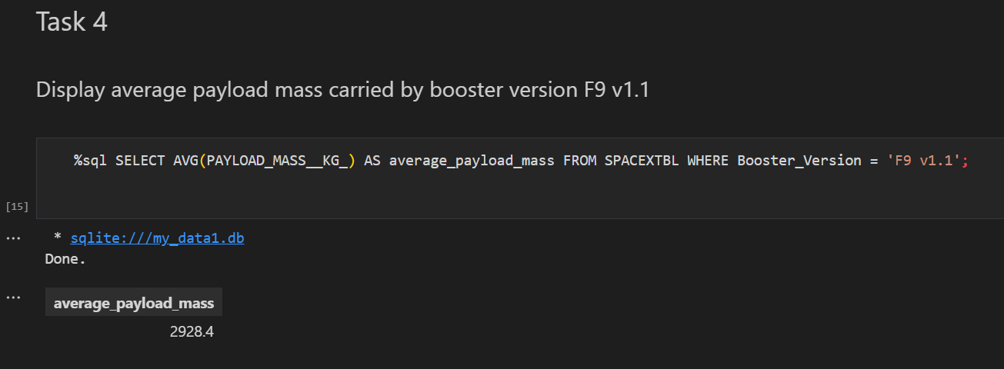
Average Payload Mass by F9 v1.1
This query determines the average (mean) value of payload mass in kilograms for all launches that used the specific booster version 'F9 v1.1'. According to the result displayed, the average payload mass for this booster version is 2928.4 kg.

Slide 28
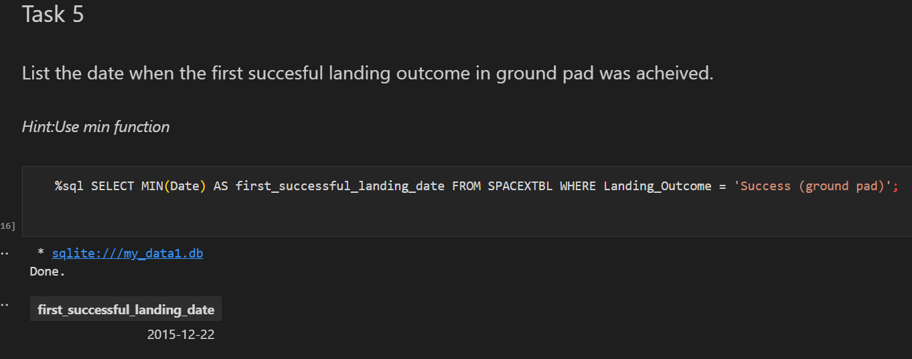
First Successful Ground Landing Date
The MIN(Date) function is applied to select the earliest date from the table SPACEXTBL where the landing outcome was a success on a ground pad. The result of this query is the date 2015-12-22, indicating that the first successful ground pad landing occurred on December 22, 2015.

Slide 29
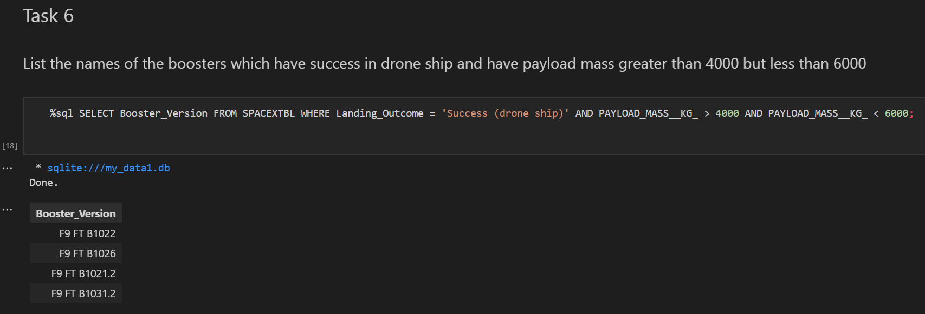
Successful Drone Ship Landing with Payload between 4000 and 6000
This indicates that these four booster versions successfully landed on a drone ship and were carrying payloads within the specified mass range.

Slide 30
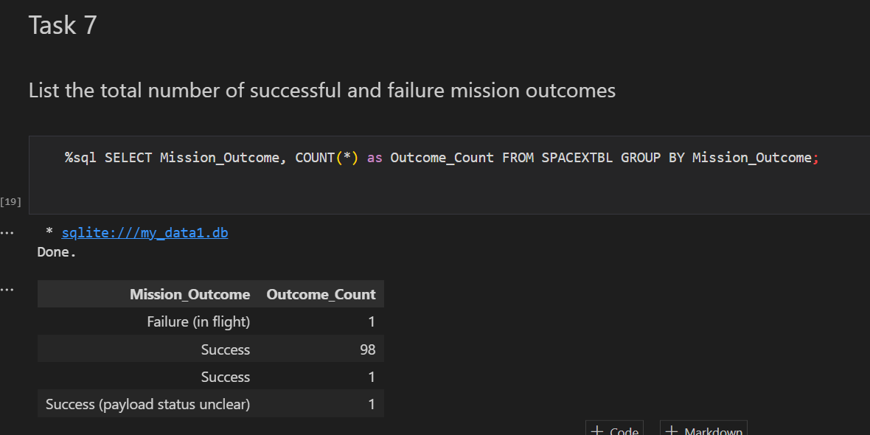
Total Number of Successful and Failure Mission Outcomes
This SQL statement classifies each mission outcome as 'Success' if the Mission_Outcome column contains the word "Success", as 'Failure' if it contains the word "Failure", and as 'Other' for all other outcomes. Then, it counts the number of occurrences for each category.

Slide 31
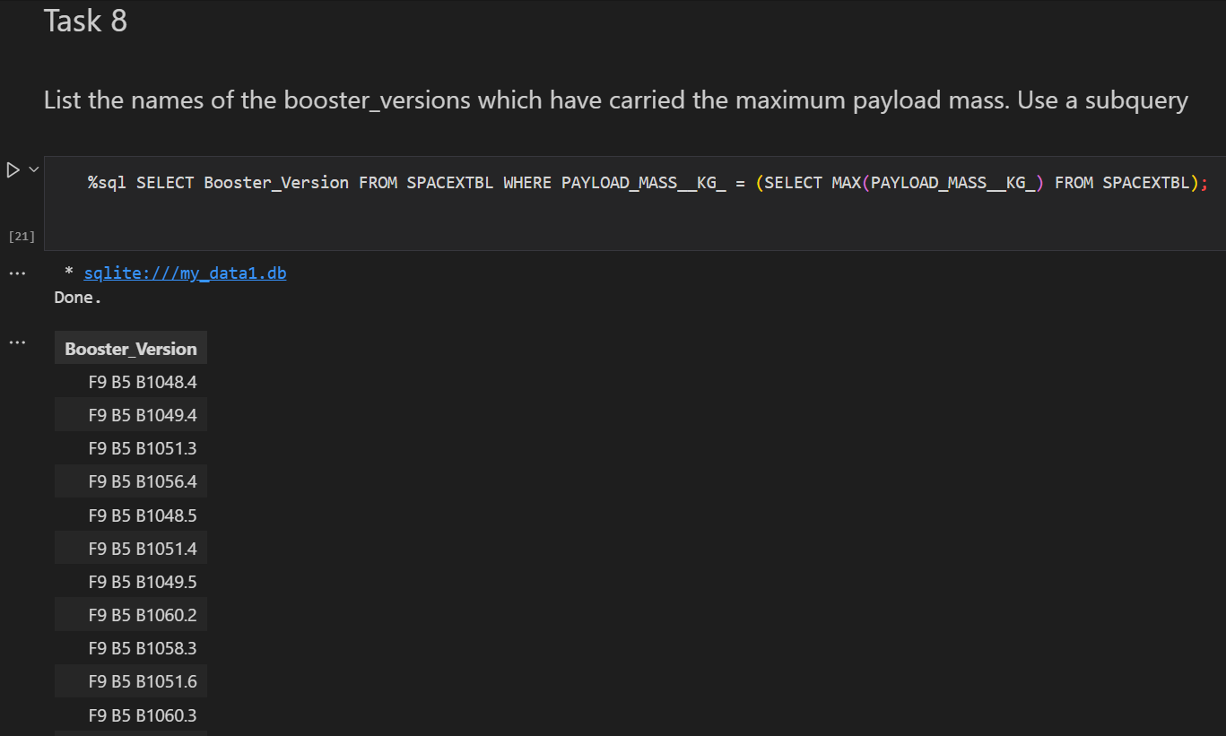
Boosters Carried Maximum Payload
The result is a list of booster versions that have carried payloads equal to the maximum payload mass recorded in the database. The list includes several versions of the Falcon 9 Block 5 booster, indicating that these specific versions have been used to launch the heaviest payloads.

Slide 32
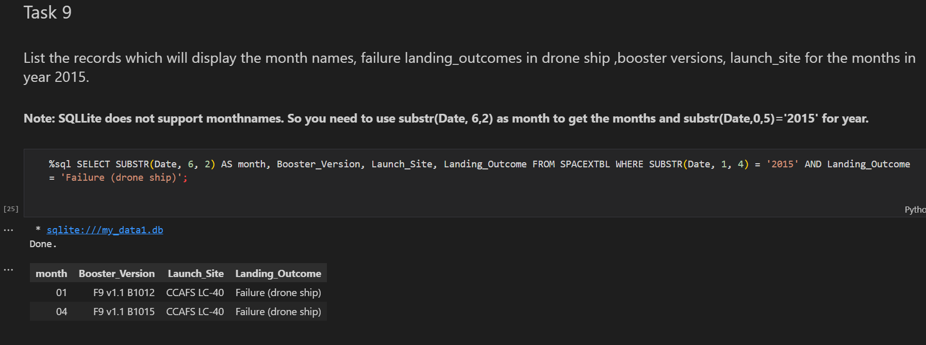
2015 Launch Records
The query then filters for landing outcomes that were failures on a drone ship. The results shown include two records from January and April of 2015, both with failures in drone ship landings.

Slide 33
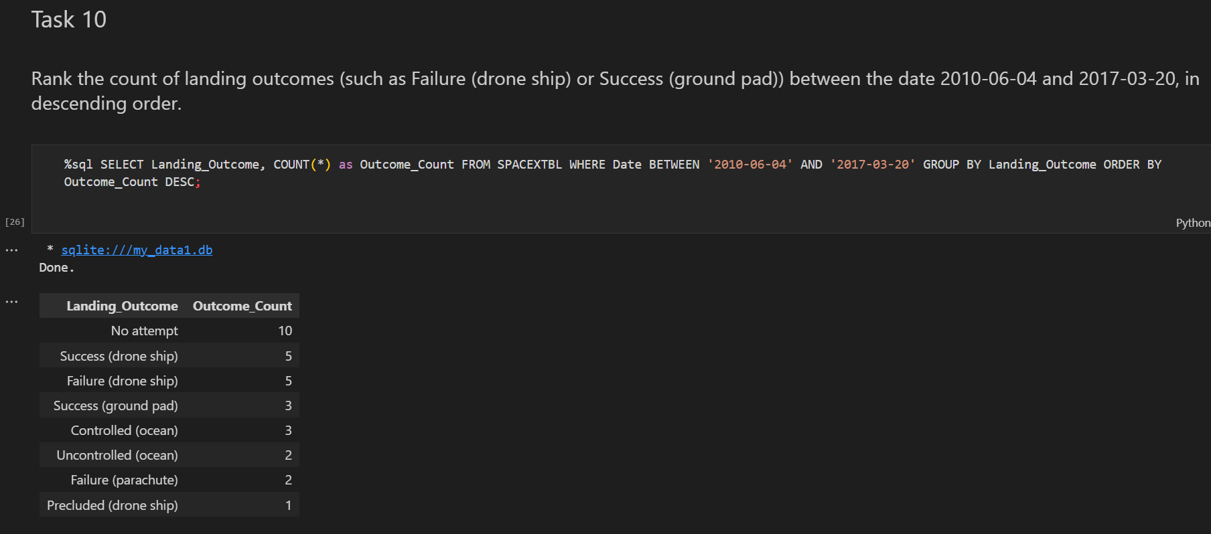
Rank Landing Outcomes Between 2010-06-04 and 2017-03-20
The resulting data shows that 'No attempt' at landing is the most common outcome, with 10 occurrences. This is followed by an equal number of 'Success (drone ship)' and 'Failure (drone ship)' outcomes, each with 5 occurrences. There are also instances of successful ground pad landings, controlled and uncontrolled ocean landings, and a couple of failures related to parachutes, with a single instance of a 'Precluded (drone ship)' outcome.

Slide 34

Section 3

Slide 35

All launch sites global map markers

Slide 36

Markers showing launch sites with color labels

Slide 37

Launch Site distance to landmarks

Slide 38

Section 4

Slide 39

Pie chart showing the success percentage achieved by each launch site

Slide 40

Pie chart showing the Launch site with the highest launch success ratio

Slide 41

Scatter plot of Payload vs Launch Outcome for all sites, with different payload selected in the range slider

Slide 42

Section 5

Slide 43
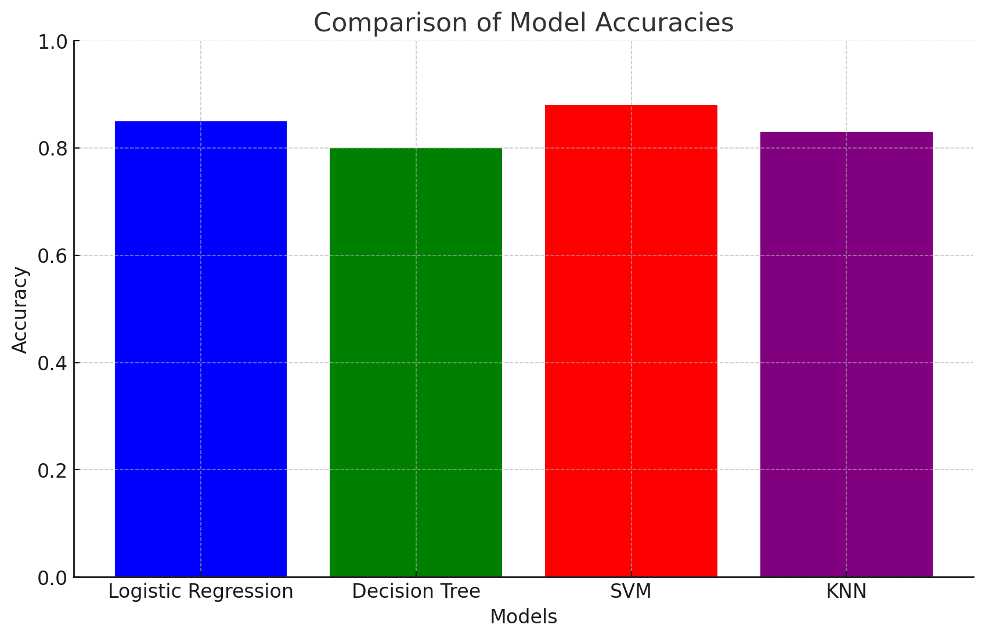
Classification Accuracy
Here is the bar chart showing the accuracy of each model: Logistic Regression, Decision Tree, Support Vector Machine (SVM), and K-Nearest Neighbors (KNN). The chart visualizes their respective accuracies, providing a clear comparison of their performance

Slide 44

Confusion Matrix
The confusion matrix for the decision tree classifier shows that the classifier can distinguish between the different classes. The major problem is the false positives .i.e., unsuccessful landing marked as successful landing by the classifier.

Slide 45
Conclusions
We can conclude that:
The larger the flight amount at a launch site, the greater the success rate at a launch site.
Launch success rate started to increase in 2013 till 2020.
Orbits ES-L1, GEO, HEO, SSO, VLEO had the most success rate.
KSC LC-39A had the most successful launches of any sites.
The Decision tree classifier is the best machine learning algorithm for this task.

Slide 46


